Slide 1
Section 1.2 Linear Functions and Applications

Slide 2
Function
Domain of a function
Function notation review

Slide 3
The Cost Function
Total cost = fixed cost + variable cost
Fixed cost is a constant and does not change as more items are made
Variable cost is a cost per item for materials, packing, shipping, etc.
The cost function for producing x items is
where m is the variable cost and b is the fixed cost

Slide 4
The Marginal Cost
The marginal cost is the rate of change of cost C(x) at a level of production x. It approximates the cost of producing additional item.
With linear function, the marginal cost is the slope m, which is a constant.
EX: C(x) = 40 x + 150
The marginal cost is
40

Slide 5
The Revenue Function
The revenue from selling x units of an item of price p is given by the function

Slide 6
The Profit Function
The profit from producing and selling x units of an item is given by the function

Slide 7
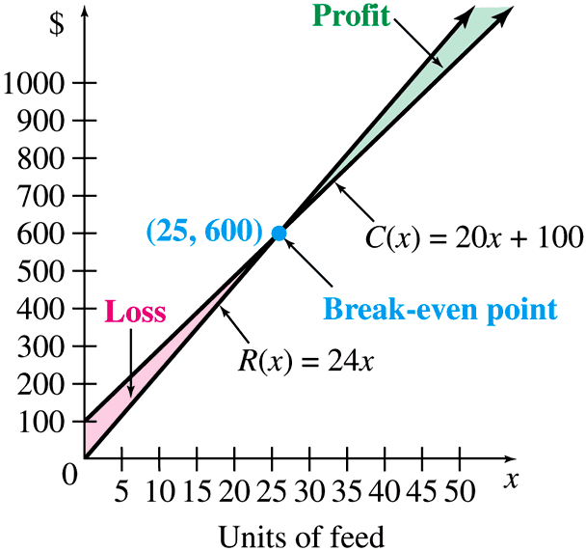
Break-even Analysis
The points at which the revenue equals the cost is called the break-even point.

Slide 8
Demand Function
The quantity consumed q, or demand, will increase as the price p decreases.
The demand function is a decreasing function. In economics, we often write the price p in terms of q although p seems to be an independent variable.

Slide 9
Supply Function
The quantity produced q, or supply, will increase as the price p increases.
The supply function is an increasing function.

Slide 10
Equilibrium Point
A surplus occurs if supply exceeds demand.
A shortage occurs if demand exceeds supply.
An equilibrium is achieved when supply = demand. The point at which the supply function equals the demand function is called equilibrium point.
The corresponding price is called equilibrium price
The corresponding quantity is called equilibrium quantity.

Slide 11
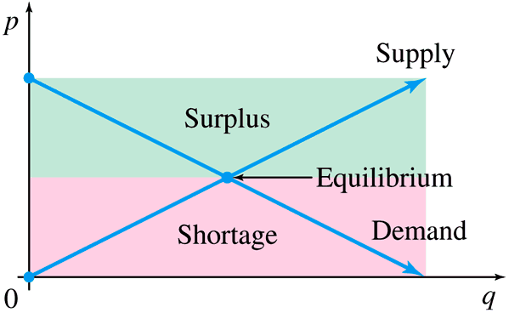
Equilibrium Point

Slide 12
Example
John, a manager of a supermarket has studied the supply and demand for watermelons. He has determined that the quantity (in thousands) demanded weekly, q, and the price per watermelon, p, are related by the linear function
He has also found the following supply function

Slide 13
Example
Find the demand and the supply at a price of $5.25 per watermelon.
Find the demand and the supply at a price of $3.75 per watermelon.
Find the equilibrium price and quantity.

Slide 14
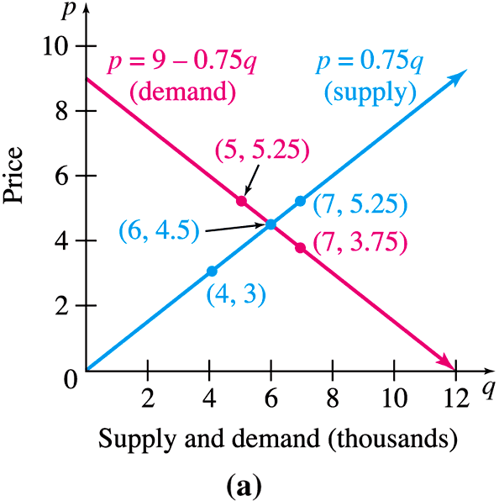
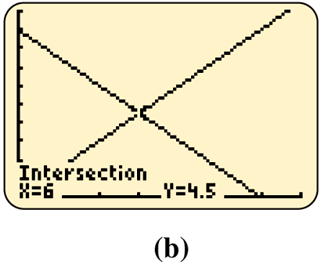
Graphs of Supply and Demand

